Slide 1


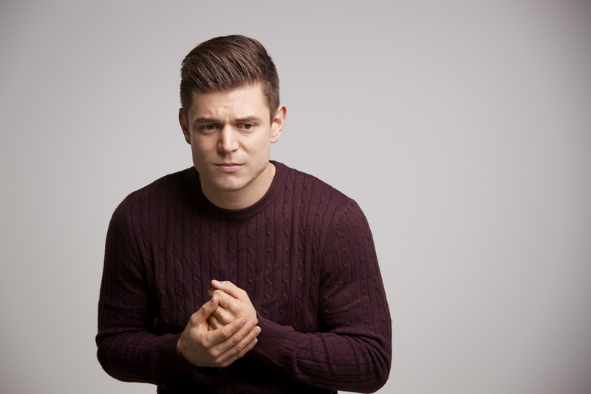
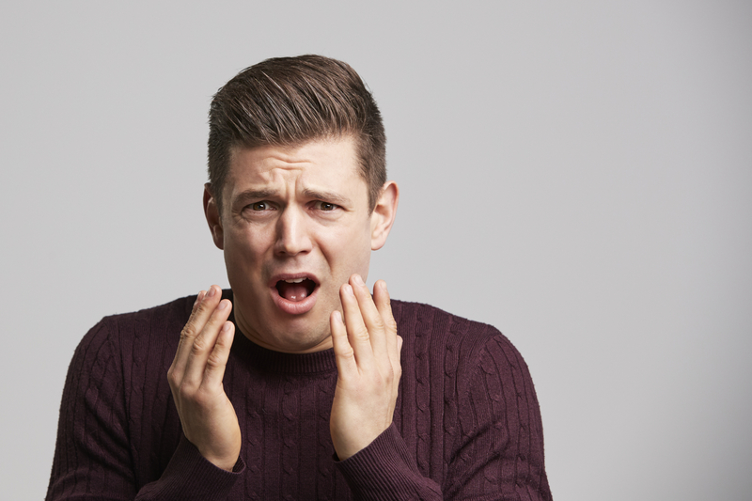
The Power of Facial Expressions
Notes:
An important part of non-verbal communication is recognizing that facial expressions often tell you just as much – or more – than the words someone is saying. A lot of research has been done into facial expressions, and scientists have discovered that around the world there are 7 facial expressions that look the same regardless of where people come from, what their language or cultural background is, their gender, or their abilities. In fact, studies show that people who are blind and have never seen these facial expressions still use them, which demonstrates that they’re instinctual.
What’s interesting about instincts is that it’s hard not to follow them. Even when someone is trying to control their facial expressions so you only learn from what their words are saying, something called “microexpressions” often appear. These short flashes of facial expression can be excellent clues to what someone really means when they’re speaking.
Let’s take a look at each of those 7 universal facial expressions, how you can recognize them, and what they mean.

Slide 2
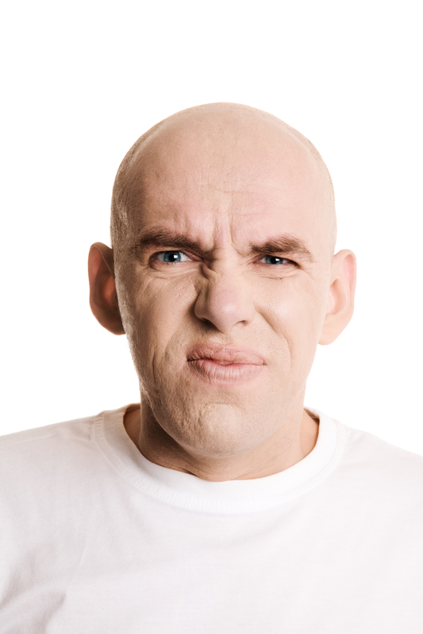
Disgust
Upper lip raised
Nose wrinkled
Eyes narrowed
Eyebrows lowered
Physically recoiling
Notes:
The first is Disgust. It’s the face you make when you smell or taste something bad. The first thing you’ll notice is that the upper lip raises, and the nose is wrinkled. Eyes often narrow, causing wrinkles in the corners, and eyebrows lower. This facial expression is often accompanied by a body movement that instinctually distances the person from the thing that disgusts them.
◉ While discussing this expression, make it yourself, and point out the areas of your face that are impacted by “disgust”.
While it’s obvious that you’d see this expression if someone were to pour spoilt milk in their cereal, it can also come out if they don’t like a person or an idea. Watch for this microexpression, and if you see it you can anticipate that the person making it is not pleased with the subject at hand – no matter what their words say.
◉ Direct the group to practice making this expression themselves, really taking notice of the areas of the face that are at play when they do.

Slide 3
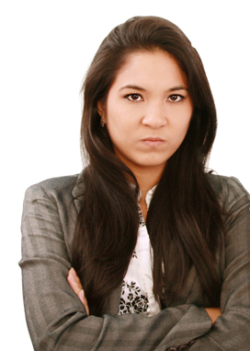
Anger
Eyebrows pinched
Vertical wrinkles between brows
Eyes narrowed
Lips tense
Notes:
The next is Anger. When someone is angry, you’ll often notice that their eyebrows are drawn together creating vertical lines between them. Their eyes may narrow, often using the muscles just below the eyes rather than those above, and their lips will appear tense and pinched.
◉ While discussing this expression, make it yourself, and point out the areas of your face that are impacted by “anger”.
Watch in particular for someone who pinches or flairs their nostrils or juts out their lower jaw – both of these are physical signs that an angry confrontation is about to happen.
◉ Direct the group to practice making this expression themselves, really taking notice of the areas of the face that are at play when they do.

Slide 4
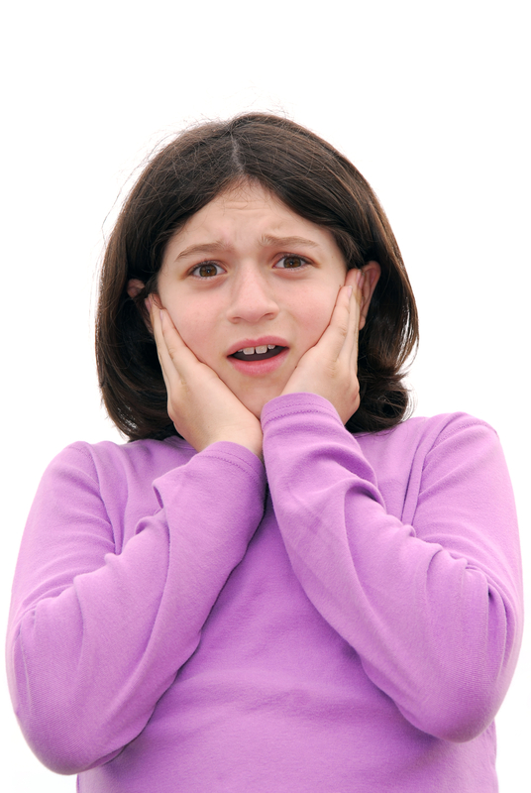
Fear
Eyebrows raised and flat
Eyes wide
Mouth open
Lips tense
Notes:
When someone instinctively respond to Fear, several things happen. First, their eyebrows raise and pull slightly to the centre making them flat and causing wrinkles in the centre, and their eyes open wider. You often see the whites of someone’s eyes above their pupils when they’re feeling fear. Their mouth opens and lips are tense.
◉ While discussing this expression, make it yourself, and point out the areas of your face that are impacted by “fear”.
Whether the person making this expression realizes it or not, they’re doing some really effective things in that state of fear. Their eyes widen to see the threat more clearly, for example. Their open mouth and intake of break get oxygen to the brain quickly, but makes sure they have enough air to either yell or run – a direct reflection of the automatic fight or flight instinct.
◉ Direct the group to practice making this expression themselves, really taking notice of the areas of the face that are at play when they do.

Slide 5

Sadness
Eyebrows raised in centre
Forehead wrinkles
Mouth drawn down at the corners
Lower lip pout
Notes:
Here we have Sadness. When someone expresses sadness through their facial features, it often shows in their eyebrows being drawn together and raised in the centre, making forehead wrinkles more noticeable. The corners of their mouth will be drawn down into a frown, and cheekbones become less pronounced.
◉ While discussing this expression, make it yourself, and point out the areas of your face that are impacted by “sadness”.
Lips may be pinched together, but sometimes you’ll see the lower lip jutting out as well. This is a common thing to notice in young children before they learn to control their facial expressions more as adults – the pout of sadness.
◉ Direct the group to practice making this expression themselves, really taking notice of the areas of the face that are at play when they do.

Slide 6

Happiness
Mouth drawn up at the corners
Cheeks rounded
Crows feet at corner of the eyes
Notes:
Let’s look at happiness. It’s a common expression, but an easier one to fake, so we’ll talk about how to tell if that happy expression is more likely to be genuine or fake. The first thing we see is that the persons mouth is drawn up into a smile. Their cheek muscles are engaged so you can see them clearly, and the line between the side of the nose and the corner of the mouth become more pronounced.
◉ While discussing this expression, make it yourself, and point out the areas of your face that are impacted by “happiness”.
Anyone can make their mouth smile, but where genuine happiness is shown is the eyes. We don’t just mean a twinkle in the eyes, but the “crows feet” wrinkles that appear in the outer corner of the eyes, and the wrinkles underneath, that appear.
◉ Direct the group to practice making this expression themselves, really taking notice of the areas of the face that are at play when they do.

Slide 7

Surprise
Eyebrows raised and rounded
Horizontal wrinkles on forehead
Mouth open and relaxed
Notes:
Surprise is expressed with several facial movements that are similar to how fear is expressed – the eyebrows raise and the mouth often falls open. The difference lies in muscle tension. When surprised, the eyebrows raise in a more round fashion, and wrinkles don’t appear between them – they’re more likely to appear horizontally across the forehead. The jaw is also more relaxed, so while someone’s mouth may drop open you don’t see the tension around the mouth the same way as you do with fear.
◉ While discussing this expression, make it yourself, and point out the areas of your face that are impacted by “surprise”.
When you consider that microexpressions are often impossible to avoid making, can be very helpful to recognizing the difference between fear and surprise. If you were to ask your boyfriend or girlfriend if they knew how your car got scratched and they show surprise, it’s likely they didn’t even know it happened. If they show fear instead? They probably know about it because they were the ones who did it.
◉ Direct the group to practice making this expression themselves, really taking notice of the areas of the face that are at play when they do.

Slide 8
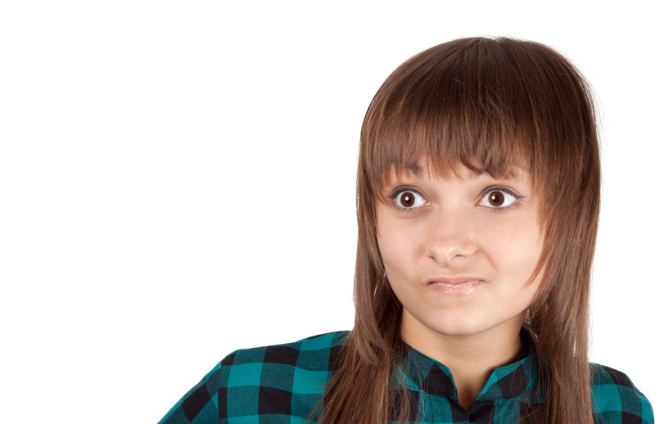
Contempt
Mouth pulled to one side
Sneer or smirk
Little impact on the rest of the face
Notes:
The expression of Contempt is a tricky one, because it really only impacts one area of the face. The eyes aren’t really in play – contempt lies in a one-sided mouth movement that looks like a sneer or a smirk.
◉ While discussing this expression, make it yourself, and point out the areas of your face that are impacted by “contempt”.
This is another great “tell” that can reveal if someone’s words and actual feelings match. If someone asks you what you think of your new neighbours, for example, and you say “yeah, they’re okay” but lips reveal a slight smirk, even as a microexpression, you’re saying something very different.
◉ Direct the group to practice making this expression themselves, really taking notice of the areas of the face that are at play when they do.

Slide 9
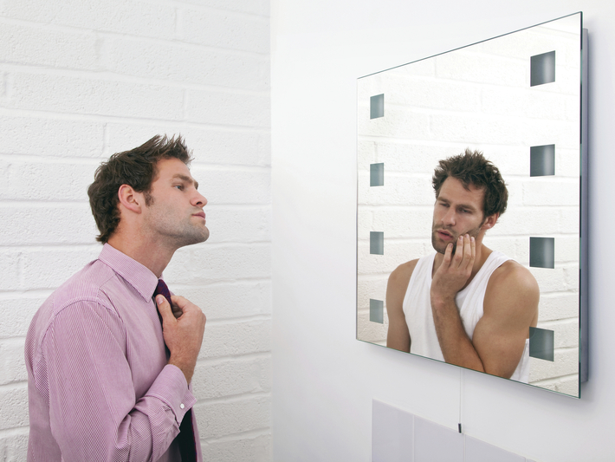
Be aware of microexpressions
And the story they tell
Notes:
Learning how to recognize these 7 emotion-based facial expressions in others, even when they appear only briefly, gives you a big advantage. So does recognizing them in yourself – because ultimately you want to be in control of what you communicate to others, both verbally and non-verbally.

